Slide 1



Engaging Clinicians in CAUTI Prevention:
Tales from the Trenches
Sanjay Saint, MD, MPH
George Dock Collegiate Professor of Internal Medicine
University of Michigan Medical School
Ann Arbor VA Medical Center
Notes:
I would like to begin by acknowledging my collaborators.

Slide 2
Catheter-Associated
Urinary Tract Infection (CAUTI)
UTI causes ~ 35% of hospital-acquired infections
Most due to urinary catheters
~20% of inpatients are catheterized
Leads to increased morbidity and healthcare costs
CMS no longer reimburses for the additional costs of hospital-acquired CAUTI
Notes:
Urinary tract infection causes over 40% of hospital-acquired infections, making it the most common nosocomial infection.
Most of these infections are due to urinary catheters.
25% of inpatients are catheterized at some time during their hospital stay.
Nosocomial UTI leads to increased morbidity and increased costs.

Slide 3
Satisfaction survey of 100 catheterized VA patients:
42% found the indwelling catheter to be uncomfortable
48% stated that it was painful
61% noted that it restricted their ADLs
2 patients provided unsolicited comments that their catheter “hurt like hell”
(Saint et al. JAGS 1999)

Slide 4
How Can We Implement Changes to Reduce Indwelling Catheter Use?

Slide 5
A Technical Solution:
Timely Removal of Indwelling Catheters
14 studies have evaluated urinary catheter reminders and stop-orders (written, computerized, nurse-initiated)
  Significant reduction in catheter use (~2.5 days)
  Significant reduction in infection (~50%)
  No evidence of harm (ie, re-insertion) (Meddings J et al. Clin Infect Dis 2010)
Notes:
Because of these increased morbidity and costs, several preventive strategies have been attempted.
Silver-coated catheters are one such intervention used to prevent catheter-related infection.
The rationale for using silver is that this substance has in vitro antibacterial activity and is commonly used to prevent infection in burn patients.
The efficacy of silver alloy catheters in preventing urinary tract infection was shown in a recent meta-analysis of randomized trials that we performed.

Slide 6
Regularly Using to Prevent CAUTI: 2005 vs. 2009 U.S. National Data
(Krein et al. J Gen Intern Med 2011)

Slide 7

Implementing Change
Across the
State of Michigan
At Home
Notes:
I have divided these overarching themes into barriers and facilitators. First the barriers: One of the important barriers we discovered [HIT RETURN FOR NEXT BULLET] was the presence of organizational “constipators” who we define as passive-aggressive types who undermine change without active resistance. These individuals appear to be supportive of change but end up ‘gumming’ up the system, thereby requiring others to erect work-arounds to get by them. [HIT RETURN FOR NEXT BULLET]
Another important barrier was the presence of silos. These were either “Clinical/work-unit silos”: in which everyone is in their own little world; And “Economic silos” in which the cost of the practice comes from a different bucket than where the benefits flow

Slide 8
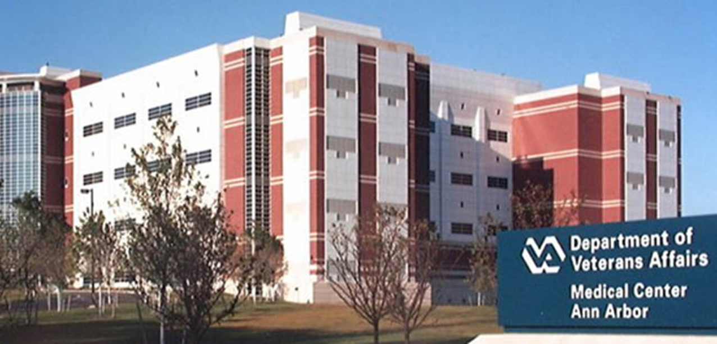
Hospital Outcomes Program of Excellence (HOPE)
(http://va-hope.org)
Systems redesign grant to Ann Arbor VAMC
Behavioral lab for interventions to improve quality and efficiency of care
CAUTI prevention one of many initiatives: nurse-initiated reminder
Notes:
I have divided these overarching themes into barriers and facilitators. First the barriers: One of the important barriers we discovered [HIT RETURN FOR NEXT BULLET] was the presence of organizational “constipators” who we define as passive-aggressive types who undermine change without active resistance. These individuals appear to be supportive of change but end up ‘gumming’ up the system, thereby requiring others to erect work-arounds to get by them. [HIT RETURN FOR NEXT BULLET]
Another important barrier was the presence of silos. These were either “Clinical/work-unit silos”: in which everyone is in their own little world; And “Economic silos” in which the cost of the practice comes from a different bucket than where the benefits flow

Slide 9
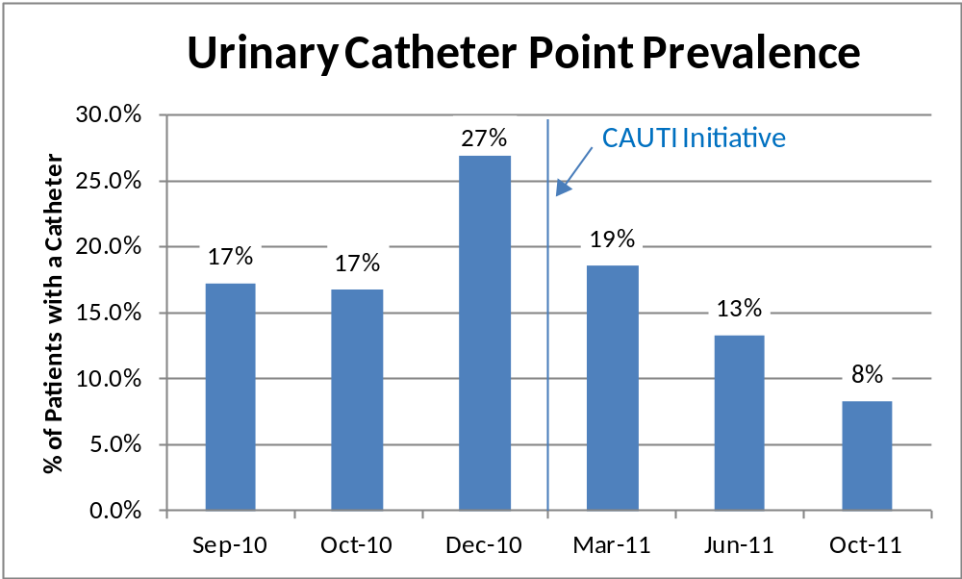
Prevalence of Urinary Catheters

Slide 10
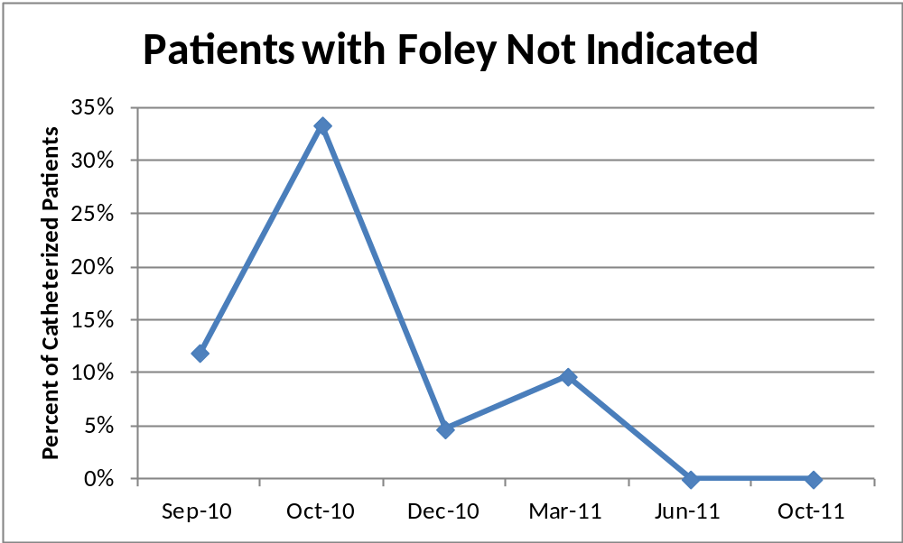
Indication for Catheter Placement

Slide 11
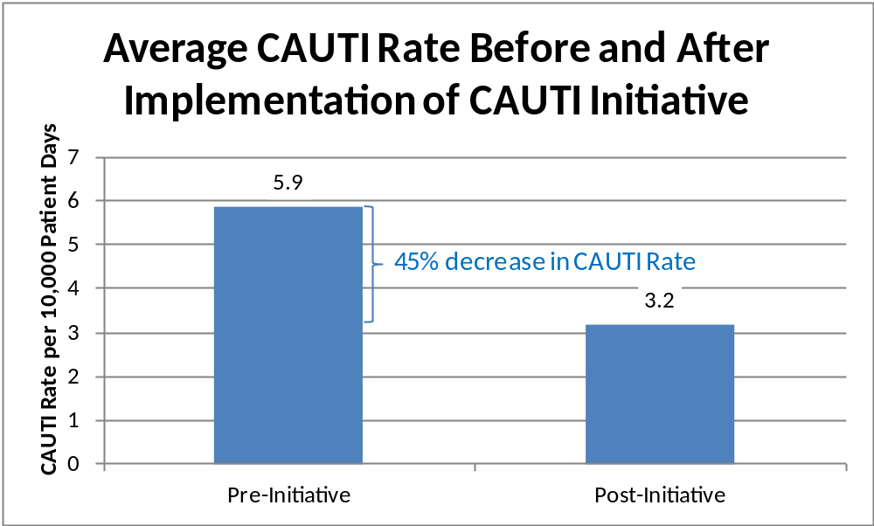
CAUTI Rate

Slide 12
A key ingredient for success is figuring out how to engage the clinicians in your hospital.
Notes:
I have divided these overarching themes into barriers and facilitators. First the barriers: One of the important barriers we discovered [HIT RETURN FOR NEXT BULLET] was the presence of organizational “constipators” who we define as passive-aggressive types who undermine change without active resistance. These individuals appear to be supportive of change but end up ‘gumming’ up the system, thereby requiring others to erect work-arounds to get by them. [HIT RETURN FOR NEXT BULLET]
Another important barrier was the presence of silos. These were either “Clinical/work-unit silos”: in which everyone is in their own little world; And “Economic silos” in which the cost of the practice comes from a different bucket than where the benefits flow

Slide 13
Outline
    CAUTI & Timely Removal of the Catheter
    Engaging Clinicians
    Future Directions

Slide 14
Physicians…
(Following slides courtesy of Dr. Fakih)
Play a significant role in shaping care in the hospital
Tend to be fairly autonomous; may not be employed by the hospital
Primarily interested in treating illness – typically not trained to focus on improving safety and preventing harm
Likely unaware of safety efforts in the hospital; most have limited time to volunteer for supporting the safety agenda
Change may not be readily embraced

Slide 15
How to Engage Physicians?
(James Reinertsen, IHI innovation Series White Paper, 2007)
Develop a common purpose (patient safety, efficiency)
View physicians as partners (not barriers)
Identify physician champions early
Standardize evidence-based processes
Provide support from leadership for the efforts of the physician champion

Slide 16
The Physician Champion & Physician Supporters
CAUTI Physician Champion
ID specialists/ Hospital Epidemiologist
Urologists
Hospitalists
Geriatricians
Emergency Medicine Physicians
Rehabilitation Medicine specialists
Surgeons
Intensivists

Slide 17
Physician Supporters: Reasons for Them to Support the Champion (or Become One…)
Infectious Disease Specialists | Urologists
Reduce CAUTI Reduce antibiotic use Reduce potential of increased resistance and Clostridium difficile disease | Reduce trauma (mechanical complications): Meatal and urethral injury Hematuria
Hospitalists | Geriatricians
Infectious and mechanical complications Potential catheter complications prolonging length of stay Often salaried physicians with incentives based on hospital-based quality and efficiency | Many elderly are frail Urinary catheters are placed more commonly in elderly inappropriately Urinary catheters increase immobility and deconditioning

Slide 18
Physician Supporters: Reasons for Them to Support the Champion (or Become One…)
Rehabilitation Specialists | Surgeons
The urinary catheter reduces mobility in patients: “one-point restraint” Rapid recovery (improvement in ambulation) may be hampered by the catheter | Surgical Care Improvement Project: Remove catheters by postop day 1 or 2 Inappropriate urinary catheter use may negatively affect the surgeon’s profile Risk of infection and trauma related to the catheter
Intensivists | Emergency Medicine physicians
Intensivists can support the evaluation of catheter need before transfer out of the ICU | Up to half of the patients are admitted through the emergency department (ED) Inappropriate urinary catheter placement is common in the ED Promoting appropriate placement of urinary catheters in the ED will reduce inappropriate use hospital-wide

Slide 19
How to Engage Nurses?
Develop a common purpose (patient safety)
View nurses as partners (not barriers)
Identify nurse champions early
Standardize evidence-based processes (and make the right thing to do, the easy thing to do)
Provide support from leadership for the efforts of the nurse champion

Slide 20
Attention to Urinary Catheters: Workload
Nursing workload can be an issue …
A nurse: “…convenience unfortunately is a high priority …especially with urinary catheters…the workload will be increased if you have to take [patients] to the bathroom or you have to change their bed a little more often ….”

Slide 21
Overcoming Barriers
Nurse buy-in is key to success
A physician administrator: “Because the nurses on the geriatrics unit wanted to have their patients regain mobility…they viewed mobility as very important …versus the other units where the nurses didn’t necessarily feel that was a real goal..”
A nurse champion is critically important!
Notes:
Nurse buy-in is therefore important.
As one physician administrator concluded: “Because the nurses on the geriatrics unit wanted to have their patients regain mobility…they viewed ambulation and mobility as a very important goal…versus the other units where the nurses didn’t necessarily feel that was a real goal in the patient’s plan for that day.”

Slide 22
Identifying the “Champion”
  Successful champions tend to be intrinsically motivated and enthusiastic about the practices they promote
  “I have a certain stature in this hospital…People know that I’m very passionate about patient care so…I get positive reinforcement from them…they’re happy to see me…because …they know that I’m thinking about what’s best for the patient…”
  (Damschroder et al., Qual and Safety in Healthcare 2009)

Slide 23
The Bedside Nurse…and Supporters
Nurse (Bedside)Champion
Infection Preventionists
Case Managers
Nurse Educator/ Manager/DON
Physical Therapists
Emergency Medicine Nurses
Intensive Care Nurses
Wound Care Nurses
Post-operative, Recovery Nurses

Slide 24
Nurse Supporters:
Reasons for Them to Support the Champion
Infection preventionists | Case managers
Reduce CAUTI Reduce antibiotic use Reduce potential of increased resistance and Clostridium difficile disease | Less complications (mechanical or infectious) = lower cost Early removal of catheter may reduce length of stay
Nurse educator/ Unit manager/Director of nursing (DON) | Physical therapists
Leader and supporter to the bedside nurse Makes appropriate urinary catheter use a priority and a safety issue Helps to address any barriers encountered by the bedside nurse | The urinary catheter reduces mobility in patients: “one-point restraint” Rapid recovery (improvement in ambulation) may be hampered by the catheter

Slide 25
Nurse Supporters:
Reasons for Them to Support the Champion
Intensive care unit (ICU) nurses | Wound care nurses
A significant opportunity is present upon transfer from the ICU to discontinue no longer needed urinary catheters ICU nurse may evaluate catheter need before transfer out of the unit and discontinue unnecessary catheters | Urinary catheter use increases immobility, which in turn results in an increased risk of pressure ulcers Wound care nurses may help in advising the bedside nurse on methods to reduce skin breakdown in patients with incontinence without using urinary catheters
Emergency medicine nurse | Post-operative recovery nurses
Up to half of the patients are admitted through the emergency department (ED) Inappropriate urinary catheter placement is common in the ED Promoting appropriate placement of urinary catheters in the ED will reduce inappropriate use hospital-wide | Urinary catheters are commonly placed preoperatively for fluid management Post-operative recovery nurses evaluate the catheter for continued need and promptly remove unnecessary catheters

Slide 26
Putting it All Together:
Key Roles and Responsibilities
Role or Responsibility | Example of Personnel to Consider
Project coordinator | Infection preventionist, quality manager, nurse manager
Nurse champion (engage nursing personnel) | Nurse educator, unit manager, charge nurse, staff nurse
Physician champion (engage medical personnel) | Urologist, ID physician, hospital epidemiologist, hospitalist
Data collection, monitoring, reporting | Infection preventionist, quality manager, Utilization manager
(Modified from www.catheterout.org)

Slide 27
Outline
    CAUTI & Timely Removal of the Catheter
    Engaging Clinicians
    Future Directions

Slide 28
The Future…
    Sustainability
    Mindfulness

Slide 29
A Dilemma
Much of what we do in healthcare – especially in the hospital – is reflexive
  If a patient is hypoxemic: we give oxygen
  Low BP: IV fluids
  Positive blood cultures: antibiotics
  Frequency, urgency, and dysuria: dx UTI

Slide 30
A Dilemma
These rote responses are usually helpful
However, this reflex-like approach can lead to problems
  Pt sick enough to be admitted from the ED: Foley catheter
  Asymptomatic catheterized patient has a “dirty” urine: antibiotics

Slide 31
One Possible Solution: “Medical Mindfulness”

Slide 32
Outline
    CAUTI & Timely Removal of the Catheter
    Engaging Clinicians
    Future Directions

